Slide 1

CASE STUDY 2
THE BUMTUM DIAPERS

Slide 2
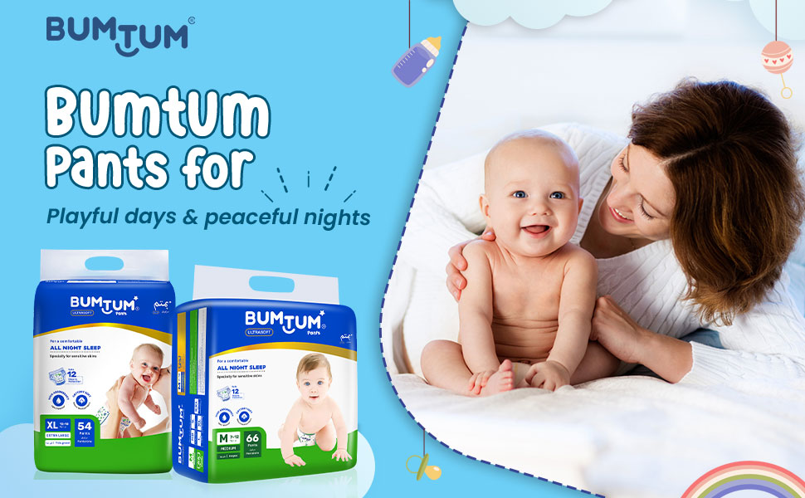
THE BUMTUM DIAPERS
Introduced in 1992 by the company noble hygiene founded by Mehta family .
Head quarters in Mumbai , Maharashtra
Known for offering a range of products tailored to the needs of Indian customers , established a strong presence in the domestic market

Slide 3
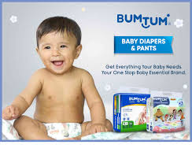
INTRODUCTION
Brand of disposable diapers designed for infants and toddlers .
They often feature like high absorbency , a comfortable fit and leak protection.
Also include absorbent core to keep the baby dry and have stretchy sides for a snug fit.
Aims to provide reliable solutions at a cost effective price .
Brand ambassador (RUBINA DILAK)
Parent company generated a revenue of INR 150cr in FY23
Head quarters : Indore , Madhya Pradesh

Slide 4
BUSINESS MODEL OF BUTUM DIAPERS
Baby care brand Bumtum aims to give a much-needed respite to the pockets of Indian parents by offering economical and quality baby diapers
The parent company generated a revenue of INR 150 Cr in FY23, up 150% YoY, and now aims to generate INR 500 Cr in revenue by the end of FY24
For efficient offline deliveries, Bumtum and it’s parent company, Familycare Consumer, joined forces with Emiza, 3PL warehousing company, to leverage its tech-driven warehousing management
Mayank revealed that the brand generates 65% of its revenue from marketplaces such as Amazon and Flipkart, while offline sales account for 35% of its total sales.
According to a report, the baby care market is projected to reach $38.51 Bn by 2029, growing at a CAGR of 17.5%.
Key Partnerships : Emiza
The strategic partnership with Emiza helps the baby care product brand leverage the former’s efficient SDD/NDD deliveries and cost-effective fulfilment specifically tailored for low-priced daily consumption items.
Emiza also serves bumtum’s parent company familycare Consumer and provides warehousing services for the brands freeme, Amigo and elduro.

Slide 5
PESTLE ANALYSIS
POLITICAL, ECONOMIC , SOCIAL, TECHNOLOGY , ENVIRONMENT , LEGAL

Slide 6
P
O
L
I
T
I
C
A
L
F
A
C
T
O
R
S
Regulations and Compliance:
Baby care products are heavily regulated to ensure safety and quality. Changes in regulations, such as stricter safety standards or labeling requirements, can affect production and costs.
Government Policies :
Policies supporting parental leave or child care can influence demand for baby care products. Additionally, trade policies and tariffs on imported materials or products can impact cost and supply chains.
Subsidies and Grants:
Government initiatives to support businesses in the baby care sector, such as grants or subsidies for innovation, could be beneficial.

Slide 7
E
C
O
N
O
M
I
C
F
A
C
T
O
R
S
Spending of Consumer:
Economic conditions may affect disposable income, which in turn influences spending on non-essential items, including premium baby care products.
Cost of Goods:
Fluctuations in the cost of raw materials and production can impact pricing and profit margins. For instance, increases in the price of materials like organic cotton could raise production costs.
Economic slip:
During recessions, parents might cut back on spending, potentially shifting preferences towards more budget-friendly options.

Slide 8
Changes in birth rates and family structures can influence the demand for baby care products. For example, a rise in working parents might increase demand for convenient baby care solutions.
S O C I A L F A C T O R S
There is a growing demand for organic, natural, and eco-friendly baby products. Trends in parenting and increased awareness of sustainability can drive market demand.
Cultural attitudes toward parenting and baby care practices can affect product preferences and market opportunities.

Slide 9
T E C H N O L O G Y F A C T O R S
Product Innovation:
Advances in technology can lead to the development of new and improved baby care products. Innovations such as smart baby monitors or eco-friendly materials could provide a competitive edge.
E-Commerce:
The growth of online shopping platforms and digital marketing can expand reach and sales channels. Investments in e-commerce technology can enhance customer experience and streamline operations.
Manufacturing Technology:
Improvements in manufacturing processes can reduce costs, increase efficiency, and enhance product quality

Slide 10



ENVIRONMENTAL FACTORS
Sustainability:
Increasing consumer demand for environmentally friendly and sustainable products requires companies to consider eco-friendly practices in production and packaging.
Waste Management:
Proper disposal and recycling of product packaging and manufacturing waste are important for reducing environmental impact.
Climate Change:
Climate-related factors, such as extreme weather conditions, can affect supply chains and raw material availability.

Slide 11

L E G A L
F A C T O R S
Compliance with safety standards and regulations is crucial.
Changes in legal requirements for product safety and labeling can impact production and marketing strategies.
Laws related to consumer rights and warranties must be adhered to, ensuring transparency and trust with customers.

Slide 12

THANK YOU

